Slide 1
Lab 8 Addressing Modes

Slide 2
Instruction Types
One Address Instruction
Two Address Instruction
Opcode | Address
Opcode | Address | Address
3 Address Instruction
Opcode | Address | Address | Address

Slide 3
Addressing Modes Part1
Addressing Modes
Immediate
Register Direct
Register Indirect
Direct
Indirect
Opcode | 50
Opcode | 2
Opcode | 2
Opcode | 300
Opcode | 300
li $S1,#50
move $S1, $S2
S2
S2
50
50
300
500
50
50
300
300
300
500
Effective Address
Effective Address
Effective Address
address directly contain the data

Slide 4
Addressing Modes Part2
Addressing Modes
PC-relative
Indexed
Indexed Register
PC
200
LDR
j 2
MUL
SUB
ADD
XR
2
3
7
202
200
201
202
200
203
201
204
202
Effective Address = PC(new) + Relative Address X Size of each Instruction
Effective Address = XR +Offset
Effective Address = 202 +2 x 1
Effective Address = 200 +2
Effective Address = 204
Effective Address = 202

Slide 5
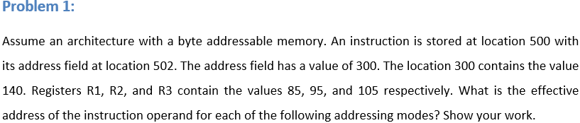
Direct Memory Addressing mode.
Indirect memory Addressing mode.
Immediate
PC-relative
Register Indirect if the location 502 contains the value 2 instead of 300.
Indexed assuming that R3 is the index register.

Slide 6
Direct Memory Addressing mode.
Indirect memory Addressing mode.
Immediate
PC-relative
Register Indirect if the location 502 contains the value 2 instead of 300.
Indexed assuming that R3 is the index register.
500
Opcode
\\
300
501
502
140
503

Slide 7
Direct Memory Addressing mode . EA = 300.
Indirect memory Addressing mode.
Immediate
PC-relative
Register Indirect if the location 502 contains the value 2 instead of 300.
Indexed assuming that R3 is the index register.
500
Opcode
\\
300
501
502
140
503

Slide 8
Direct Memory Addressing mode . EA = 300.
Indirect memory Addressing mode. EA = 140.
Immediate
PC-relative
Register Indirect if the location 502 contains the value 2 instead of 300.
Indexed assuming that R3 is the index register.
500
Opcode
\\
300
501
502
140
503

Slide 9
Direct Memory Addressing mode . EA = 300.
Indirect memory Addressing mode. EA = 140.
Immediate. EA = 502.
PC-relative
Register Indirect if the location 502 contains the value 2 instead of 300.
Indexed assuming that R3 is the index register.
500
Opcode
\\
300
501
502
140
503

Slide 10
Direct Memory Addressing mode . EA = 300.
Indirect memory Addressing mode. EA = 140.
Immediate. EA = 502.
PC-relative. EA= 503 + (300x3) = 1403.
Register Indirect if the location 502 contains the value 2 instead of 300.
Indexed assuming that R3 is the index register.
500
Opcode
\\
300
501
502
140
503

Slide 11
Direct Memory Addressing mode . EA = 300.
Indirect memory Addressing mode. EA = 140.
Immediate. EA = 502.
PC-relative. EA= 503 + (300x3) = 1403.
Register Indirect if the location 502 contains the value 2 instead of 300. EA = 95.
Indexed assuming that R3 is the index register.
500
Opcode
\\
2
501
502
R2
503
95

Slide 12
Direct Memory Addressing mode . EA = 300.
Indirect memory Addressing mode. EA = 140.
Immediate. EA = 502.
PC-relative. EA= 503 + (300x3) = 1403.
Register Indirect if the location 502 contains the value 2 instead of 300. EA = 95.
Indexed assuming that R3 is the index register. 105 + 300 = 405.
500
Opcode
\\
300
501
502
503
R3
105

Slide 13
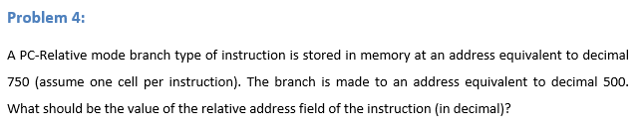
Solution:
EA = PC (new) + relative address x 1
Relative address = 500 – 751 = -251
500
Instruction
Because each instruction takes only one memory cell
……
PC (new)
750
751
751

Slide 14
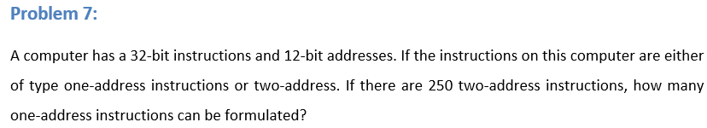
One Address
Two Address
Opcode | Unused Bits | Address
Opcode | Address | Address
8-bits
12-bits
12-bits
8-bits
12-bits
12-bits
32 bits
32 bits
$2^{8}$ = 256 combinations
256 – 250 = 6 combinations can be used for one address
$6×2^{12}$ = 24,576 instructions

Slide 15
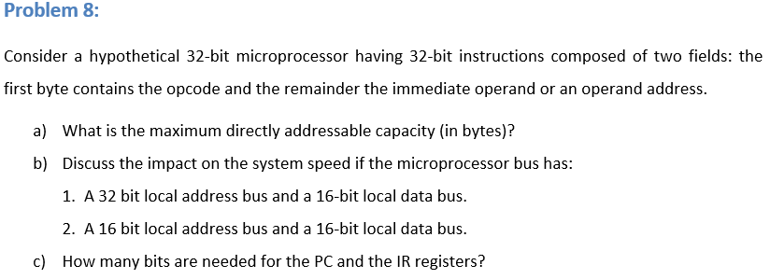
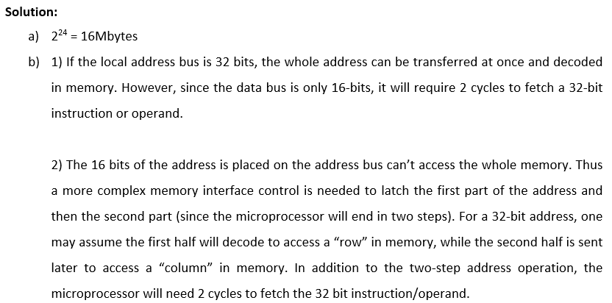
Opcode | Address
8-bits
24-bits
32 bits

Slide 16
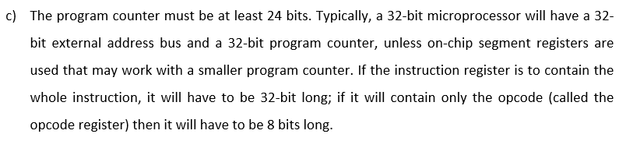
Opcode | Address
8-bits
24-bits
32 bits

Slide 17
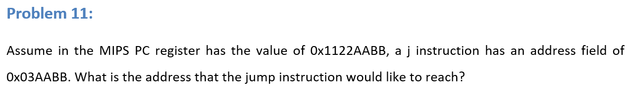
Instruction in MIPS
Opcode 6-bits | Address 26-bits
j Exit
Jump to address Exit which is 1000
32-bits
1000
8-bits
32-bits

Slide 18
Instruction in MIPS
Opcode 6-bits | Address 26-bits
j Exit
Jump to address Exit which is 1000
32-bits
1000
8-bits
Address 00
32-bits
28-bits
4 upper significant bits Address 00
32-bits

Slide 19
Instruction in MIPS
Opcode 6-bits | Address 26-bits
j Exit
Jump to address Exit which is 1000
32-bits
1000
8-bits
Address 00
32-bits
28-bits
4 upper four significant bits Address 00
32-bits
PC register
0x1122AABB

Slide 20
J Instruction
Opcode 6-bits | Address 0x003AABB 26-bits
Address = 003AABB
Address = 00 0000 0011 1010 1010 1011 1011
Address 00
Address = 00 0000 0011 1010 1010 1011 1011 00
28-bits
Address = 0001 00 0000 0011 1010 1010 1011 1011 00
4 upper four significant bits Address 00
32-bits
Address = 0001 0000 0000 1110 1010 1010 1110 1100
PC register
Address =100EAAEC
0x1122AABB

Slide 21
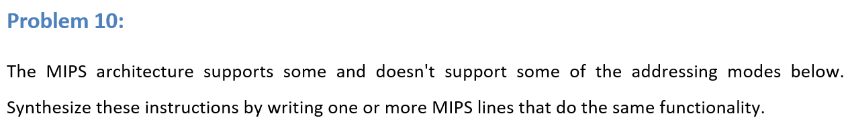
Load $s1, ($s2) // Register Indirect addressing mode.
Load $s1, @($s2) // Memory Indirect addressing mode, assuming that $S2 contains the first memory address
Load $s1, ($s2+$s3+200) // indexed with displacement addressing mode.
Load $s1, (0x1122AABB) // memory direct addressing mode.

Slide 22
Load $s1, ($s2) // Register Indirect addressing mode.
S2
50
This could be done by the following MIPS instructions:
lw $t2, 0($s2) // now $t2 has the first address.
lw $s1, 0($t2) // now $s1 has the operand.
300
300

Slide 23
b) Load $s1, @($s2) // Memory Indirect addressing mode, assuming that $S2 contains the first memory address
This could be done by the following MIPS instructions:
lw $t2, 0($s2) // now $t2 has the first memory address.
lw $t3, 0($t2) // now $t3 has the second memory address.
lw $s1, 0($t3) // now $s1 contains the operand.
300
500
50
500

Slide 24
c) Load $s1, ($s2+$s3+200) // indexed with displacement addressing mode.
This could be done by the following MIPS instructions:
add $t1, $s2, $s3
addi $t1,200
lw $s1, 0($t1) // now $s1 contains the operand.

Slide 25
d) Load $s1, (0x1122AABB) // memory direct addressing mode.
li $t1, 0x1122AABB
lw $s1, 0($t1)

Slide 26
